Slide 1
Kenya: Rolling back on fundamental freedoms?

Slide 2
Context: Human rights and fundamental freedoms
The central theme of Kenya’s constitution is human rights:
Robust and progressive 2010 constitution key for the protection of human rights.
Preamble recognizes the aspirations of Kenyans-human rights, equality, freedom, democracy, social justice and the rule of law.
Article 10-Human dignity, human rights, participation of the people.
Chapter 4-[the longest chapter] Bill of rights

Slide 3
But where are these rights now?
A reflection on status of civic space, rights of human rights defenders and CSOs.

Slide 4
Shrinking of Civic Space in Kenya and beyond
The last two years have seen widespread and routine repression of fundamental freedoms:
Right to freedom of assembly,
Right to freedom of expression,
Freedom of association.

Slide 5
Gen Z protests and aftermath
Kenya’s youth protest against Finance Bill, 2024.
Regime responded with brute and excessive force to disrupt the protests.
Missing Voices, of which KHRC is a member, documented 159 extrajudicial killings and enforced disappearances.
Notes:
The Bill was introducing heavy taxation on basic commodities such as bread. Regime used

Slide 6
Gen Z protests and aftermath
IMLU documented more than 2000 cases of police injuries and more than 600 cases of police torture.
Notes:
The Bill was introducing heavy taxation on basic commodities such as bread. Regime used

Slide 7
Repressive methods included:
Use of snipers by police.
Use of goons to disrupt peaceful protests.
Masked police (or goons?), in plainclothes, and unmarked vehicles.
Heavy, punitive charges against protestors [terrorism]!

Slide 8
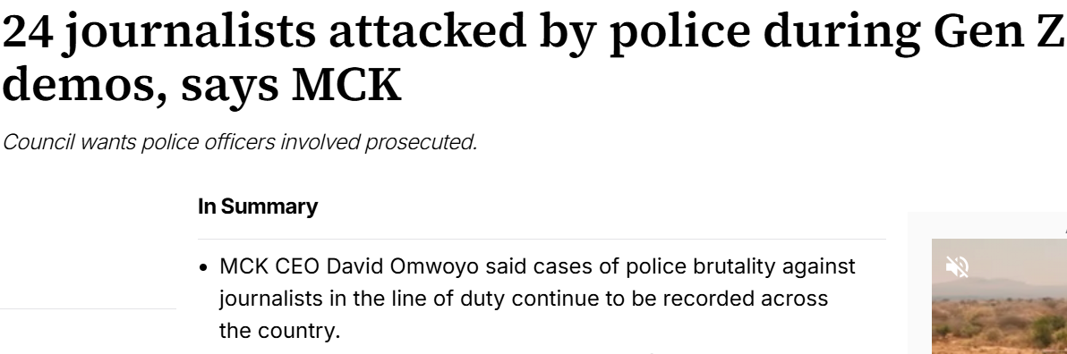
Repression beyond the streets
Killing the messenger?
Attacks on journalists during protests.
Communications Authority of Kenya turning off airwaves during the June 2025 protests to commemorate the deadly 2024 protests.

Slide 9
Repression beyond the streets
Attack on CSOs
CSOs accused of funding the protests. Ford Foundation dragged in the mud!
Intimidation of CSOs through DCI.
Brazen attack on KHRC premise and unlawful rendition of staff - a new low?

Slide 10
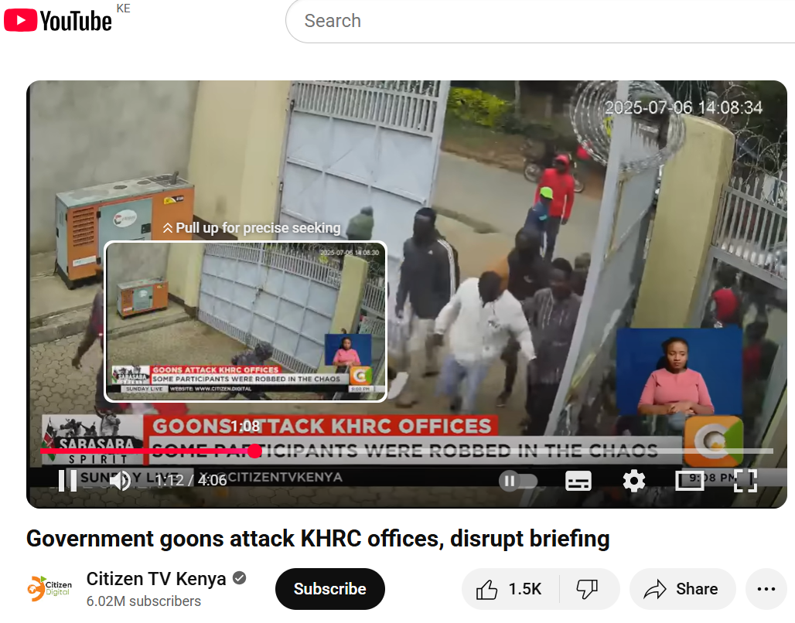

Slide 11
Oh, how Kenya has fallen!
From ‘obstructed’ to ‘repressed’.

Slide 12
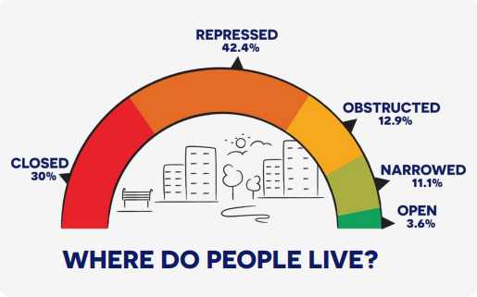
81/198 countries rated in the worst 2 categories-repressed or closed.
42.4% of the global population lives under repressive conditions.

Slide 13
Regional Context
Killing the opposition. Silencing CSOs.
Tundu Lissu’s treason trial.
Kizza Byesige’s arrest in Kenya.
Deportation of Martha Karua and former CJ Willy Mutunga.
Arrest and torture of activist Boniface Mwangi and Uganda’s Agatha Atuhaire.

Slide 14
Conservancy Actors.
Stop with the impunity!
Respect community rights-FPIC.
Employ inclusive and participatory approaches.
End intimidation and attacks on dissents and CSOs.
Collaborate with CSOs-recognise their place and role in promoting transparent and accountable conservation methods.

Slide 15
Donors, funders, development partners?
Put your money where your mouth is!
Undertake due diligence before, during and after funding.
Co-create conservation projects with communities and CSOs.
Stop propagating impunity.

Slide 16
Thank You!

